Slide 1
Reproducibility in mass spectrometry-based proteomics database searches
Iryna Abramchuk
BCH8166 - October 4, 2023

Slide 2
Mass spectrometry-based proteomics
Mass spectrometer
Digestion
Separation
Mass Analyzer
Mass Analyzer
Liquid Chromatography
Fragmentation
Ionization
(peptide ion)
Proteins
Peptides
MS1 Spectrum
MS2 Spectrum

Slide 3
Mass spectrometry-based proteomics
Mass spectrometer
Digestion
Separation
Mass Analyzer
Mass Analyzer
Liquid Chromatography
Fragmentation
Ionization
(peptide ion)
Proteins
Peptides
End of experiment:
MS1 Spectrum
MS2 Spectrum
MS2 spectra to use for identification

Slide 4
Identify peptides and proteins from MS2 spectra
Sequence database search
Experimental spectrum
Theoretical spectra
Generate spectra
VLLISDPTK
EQFVEFR
Peptide sequences
…
LDVQFSGLTK

Slide 5
Identify peptides and proteins from MS2 spectra
Sequence database search
Spectral library search
Experimental spectrum
Theoretical spectra
Spectral library
Generate spectra
Curate library
VLLISDPTK
Previously acquired spectra
EQFVEFR
Peptide sequences
…
LDVQFSGLTK
Notes:
Spectral library searching is more sensitive than sequence database searching, achieving a higher rate of spectrum identifications
analyses using spectral libraries are limited by the depth and quality of the library
an incomplete or low quality spectral library can derail analysis of even the best data

Slide 6
Issues with mass spectrometry-based proteomics
Poor reproducibility in proteins identified between replicates
Mass spectrometer
Digestion
Separation
Mass Analyzer
Mass Analyzer
Liquid Chromatography
Fragmentation
Ionization
(peptide ion)
Proteins
Peptides
MS1 Spectrum
MS2 Spectrum

Slide 7
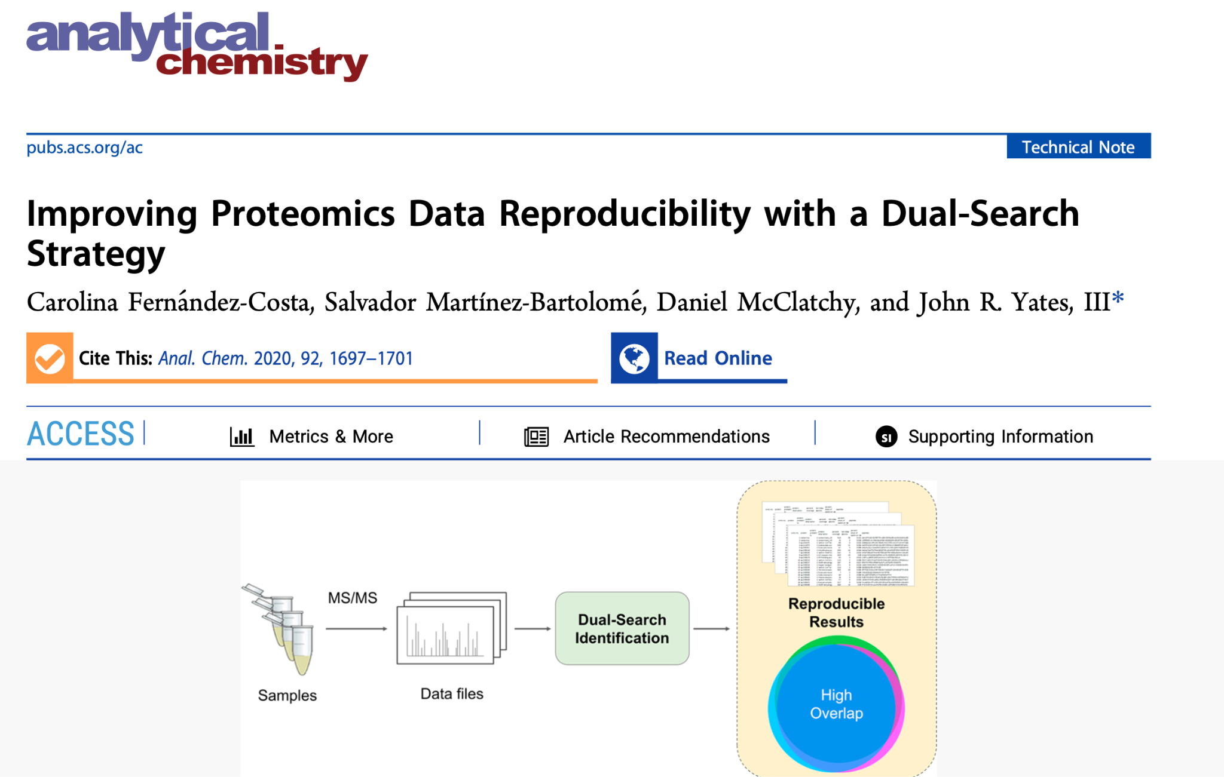

Slide 8
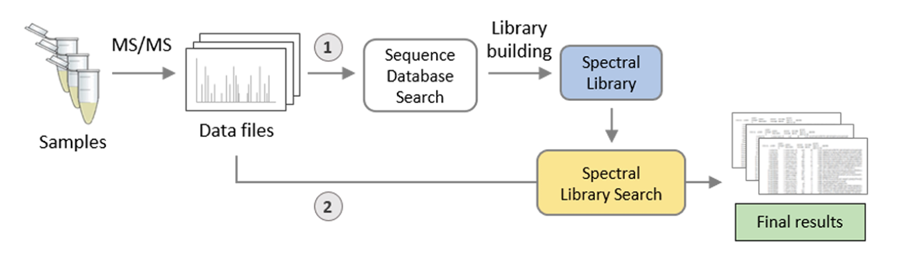
Perform a sequence database search

Slide 9
Perform a sequence database search
Use confident identifications from database search to curate a spectral library

Slide 10
Perform a sequence database search
Use confident identifications from database search to curate a spectral library
Perform a spectral library search against your curated library

Slide 11
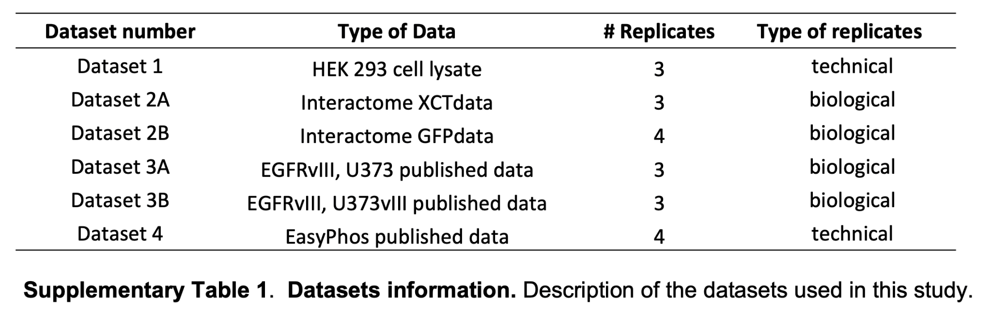

Methods overview
Database search
Compare overlap between replicates in each dataset
Dataset
Spectral library search
Dual search

Slide 12
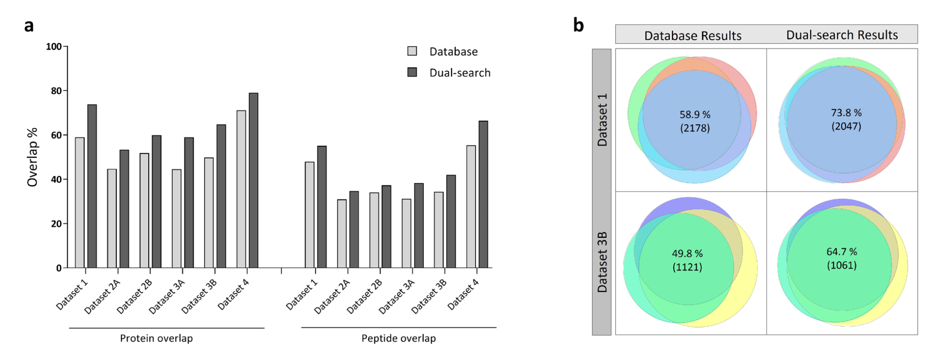
Using the dual search strategy, there is more reproducibility between the proteins/peptides identified across replicate experiments
1. Dual search = more reproducibility among replicates than database search (% and absolute numbers)
2. More overlap between technical replicates than biological replicates

Slide 13
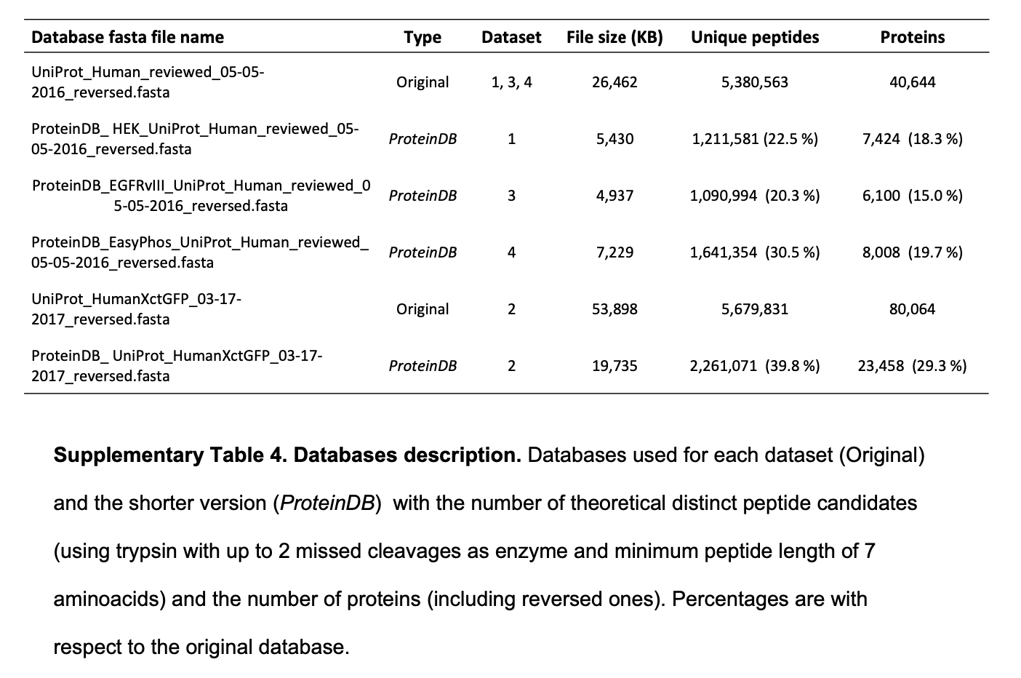
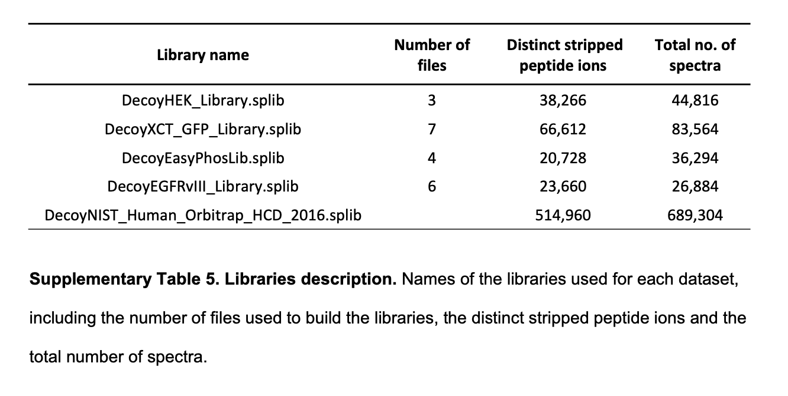
Search space effect on protein identification
Database search
~40,000 human proteins
Spectral library
~26,000-44,000 spectra
Notes:
Since differences in the search space between sequence database and spectral library searching has been claimed as a reason for the higher reproducibility of library search results,29,30 we studied the influence of search space on the identification results

Slide 14
Search space effect on protein identification
Database search
~40,000 human proteins
Spectral library
~26,000-44,000 spectra
ProteinDB / “Smaller dataset”
~6,000-8,000 proteins
NIST library / “Larger library”
~689,000 spectra
Notes:
Since differences in the search space between sequence database and spectral library searching has been claimed as a reason for the higher reproducibility of library search results,29,30 we studied the influence of search space on the identification results

Slide 15
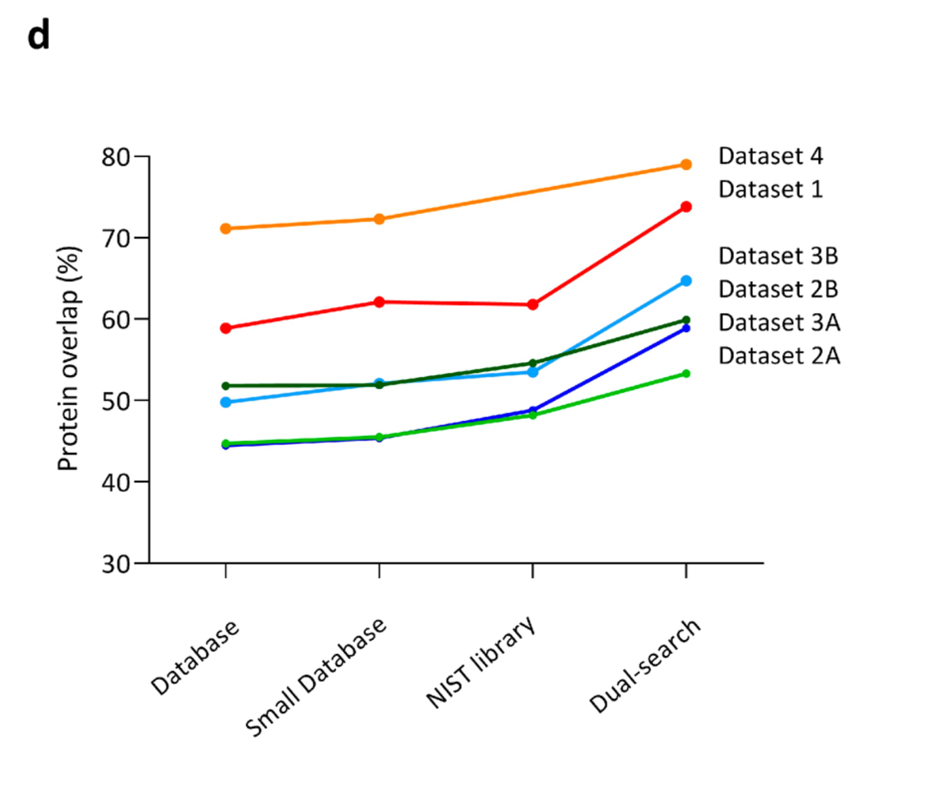
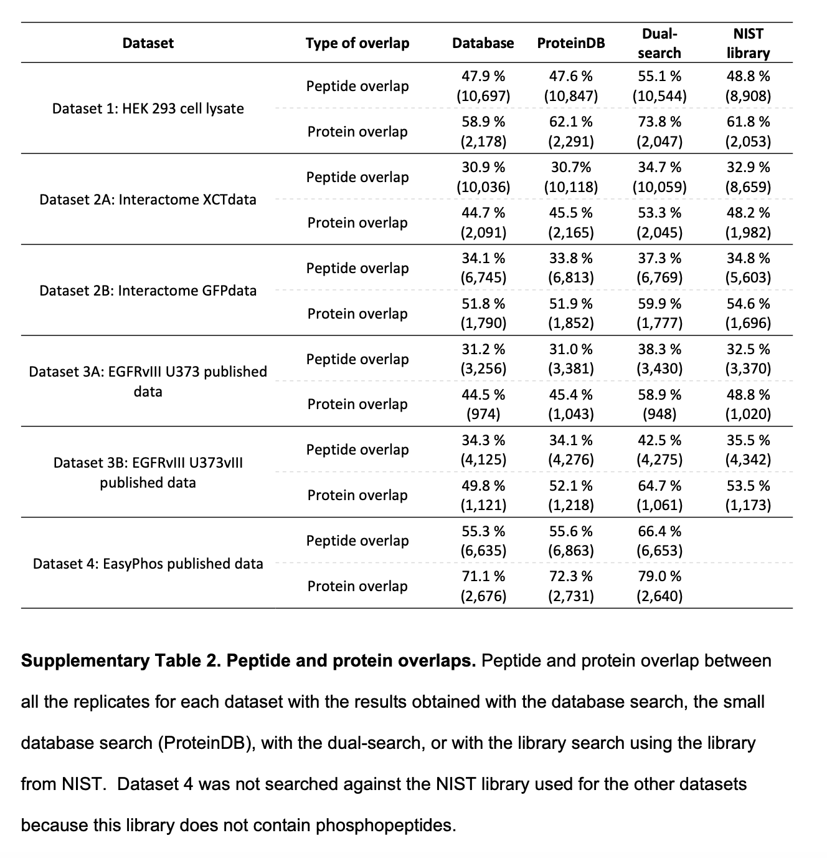
Search space has a larger effect on reproducibility between library searches than between database searches

Slide 16
Quantification reproducibility between replicate experiments
Normalized spectral abundance factor
= (# spectral counts for a protein / mass or protein length) / ∑ SAF in sample
Normalized spectral abundance factor
= abundance of a protein
Coefficient of variation = (standard deviation of NSAF) / (mean NSAF in dataset)
Measure of variation of abundances in dataset (i.e. quantification reproducibility)
Number of missing values for protein identification between dataset replicates

Slide 17
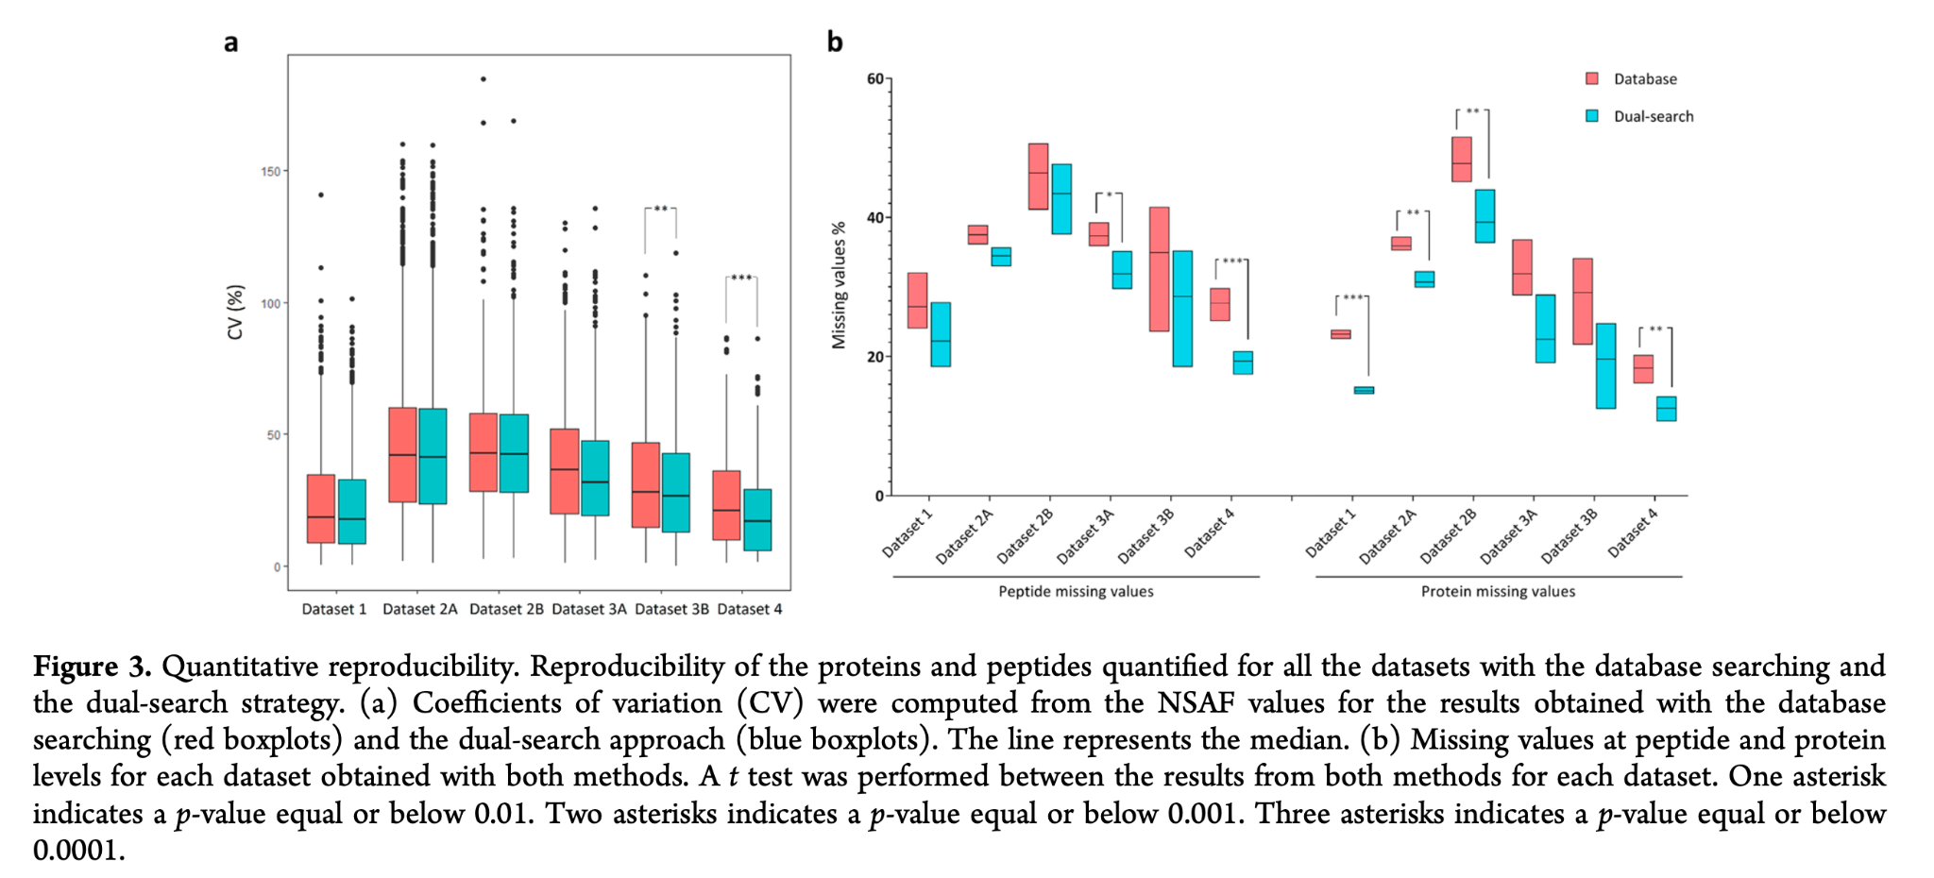
There is a higher quantification reproducibility when using the dual search method

Slide 18
Reproducibility project
Recreate analysis
Create an automated workflow for a dual-search (Nextflow, Docker)
Install and use their PACOM visualization tool (Github) for figures
Recreate analysis for their 4 datasets (check data availability, methods)
Compare results (likely for the protein overlap, if time also for quantification and search space)
Notes:
#Methods
1. Recreate analysis
- Set up workflow to automate dual-search strategy
- Install PACOM visualization tool
- Download and run dual-search on 4 datasets used
- Compare figures and results (from dual-search strategy only, not additional quantification reproducibility and search space analyses)
2. Apply workflow to additional datasets
- Compile heterogenous set of datasets (different instruments, experiments, yield sizes)
- Run dual-search, run PACOM
- Same effect? (i.e. increased reproducibility)
Additional thoughts
- Try Snakemake or Nextflow
- Try Docker? Might not be applicable to this
- Potential add-on for step 1: recreate dual-search strategy in a git+snakemake+docker pipeline so it is automated and ready to go for the next time I want to use it

Slide 19
Reproducibility project
Recreate analysis
Create an automated workflow for a dual-search (Nextflow, Docker)
Install and use their PACOM visualization tool (Github) for figures
Recreate analysis for their 4 datasets (check data availability, methods)
Compare results (likely for the protein overlap, if time also for quantification and search space)
Apply workflow to additional datasets
Compile heterogenous proteomics datasets (different instruments, yields, experiments)
Run automated dual-search -> PACOM and compare effect on reproducibility
Notes:
#Methods
1. Recreate analysis
- Set up workflow to automate dual-search strategy
- Install PACOM visualization tool
- Download and run dual-search on 4 datasets used
- Compare figures and results (from dual-search strategy only, not additional quantification reproducibility and search space analyses)
2. Apply workflow to additional datasets
- Compile heterogenous set of datasets (different instruments, experiments, yield sizes)
- Run dual-search, run PACOM
- Same effect? (i.e. increased reproducibility)
Additional thoughts
- Try Snakemake or Nextflow
- Try Docker? Might not be applicable to this
- Potential add-on for step 1: recreate dual-search strategy in a git+snakemake+docker pipeline so it is automated and ready to go for the next time I want to use it

Slide 20
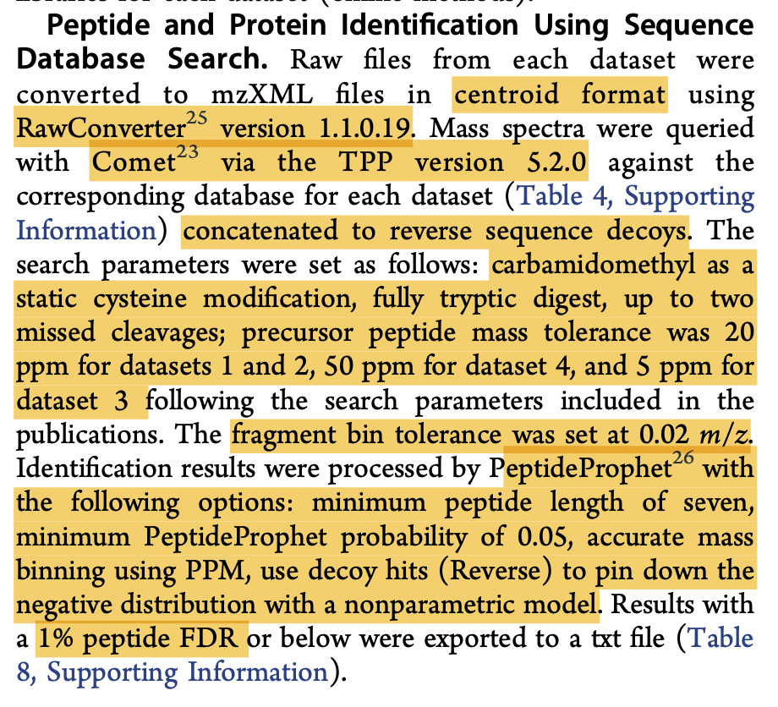
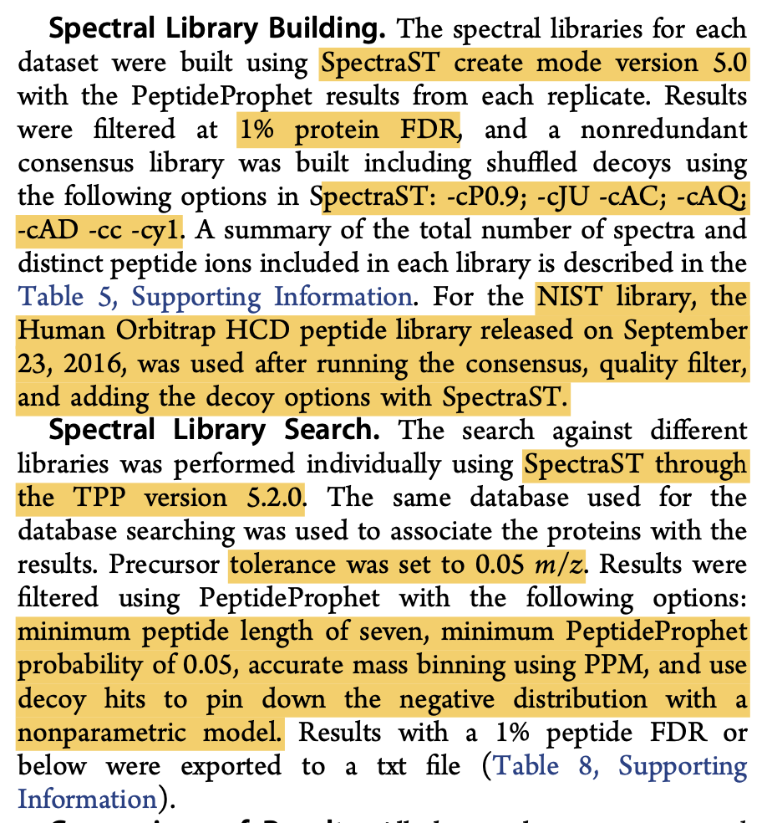
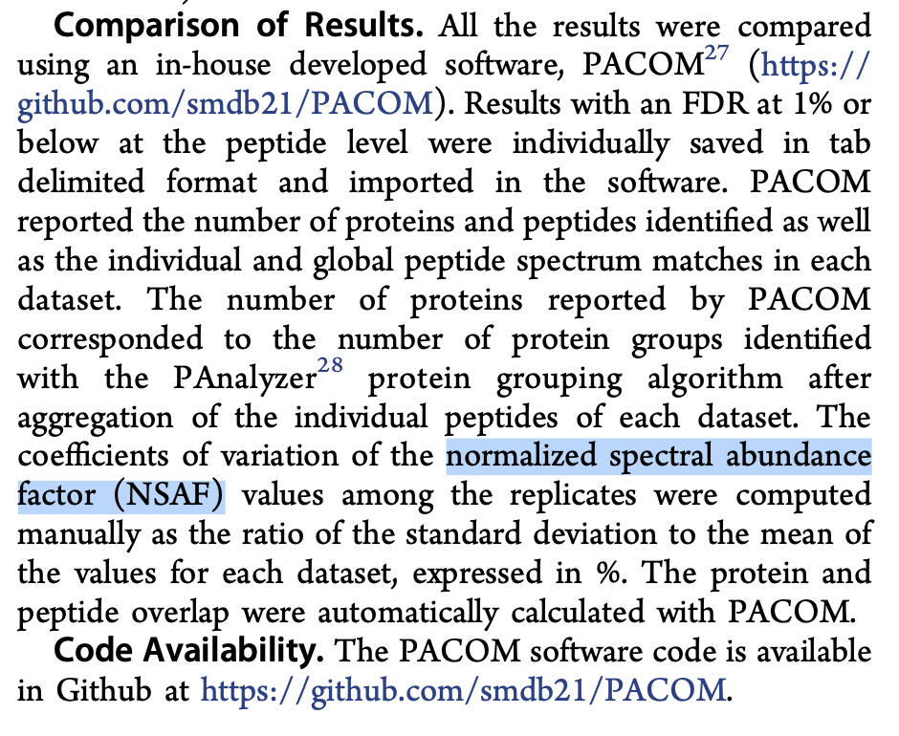
Preliminary preparation for recreating analysis
Some parameter details, not all
Unspecified parameters will be assumed default
PACOM (visualization tool) looks well maintained on GitHub

Slide 21
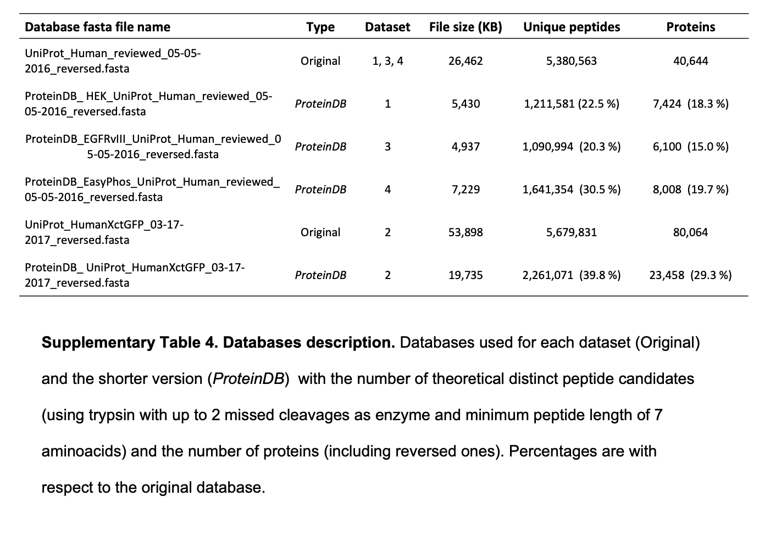
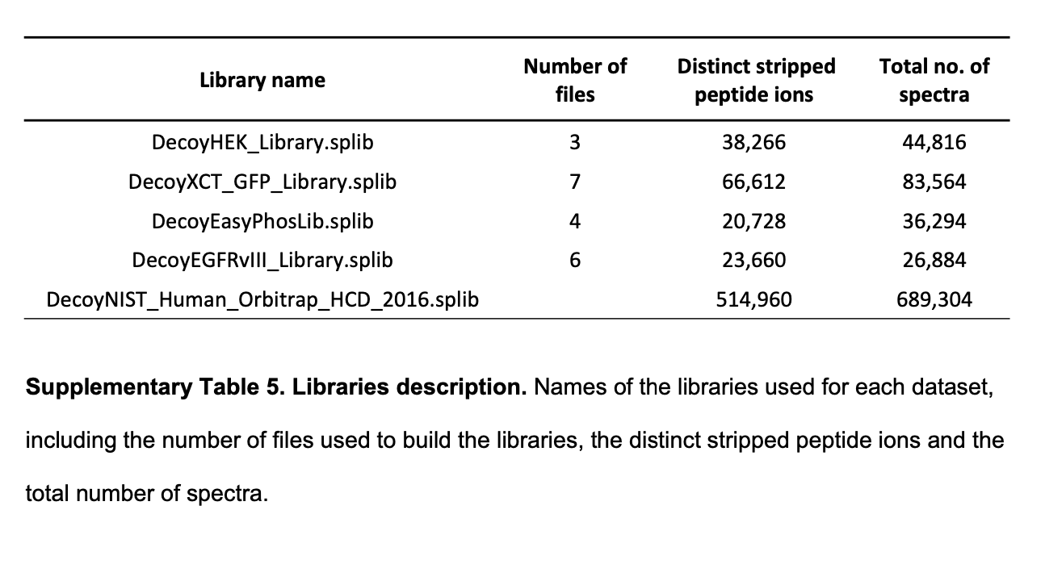
Preliminary preparation for recreating analysis
Details about datasets used (databases, libraries)
Some inference to be made from file names
Accessibility?

Slide 22
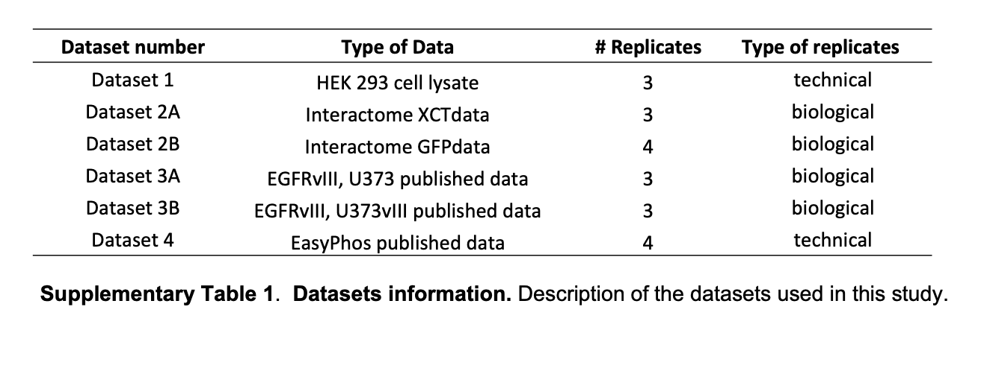
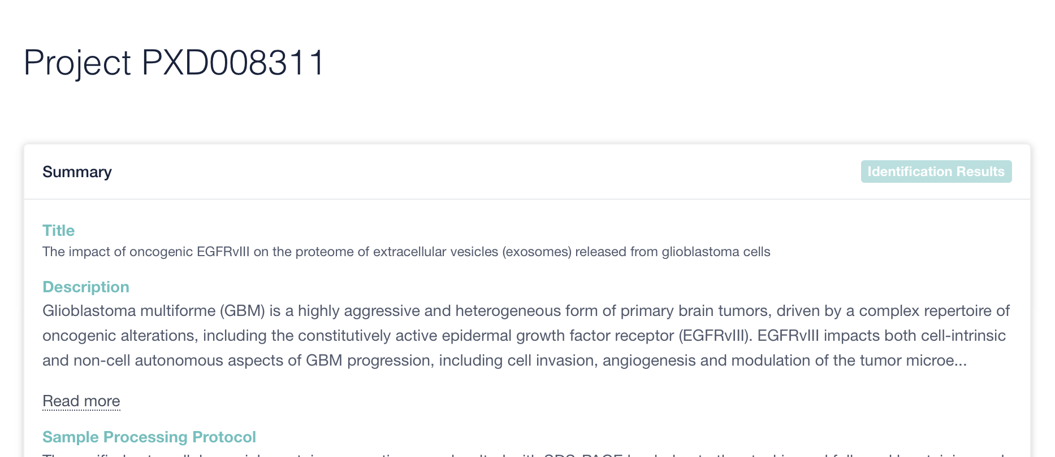
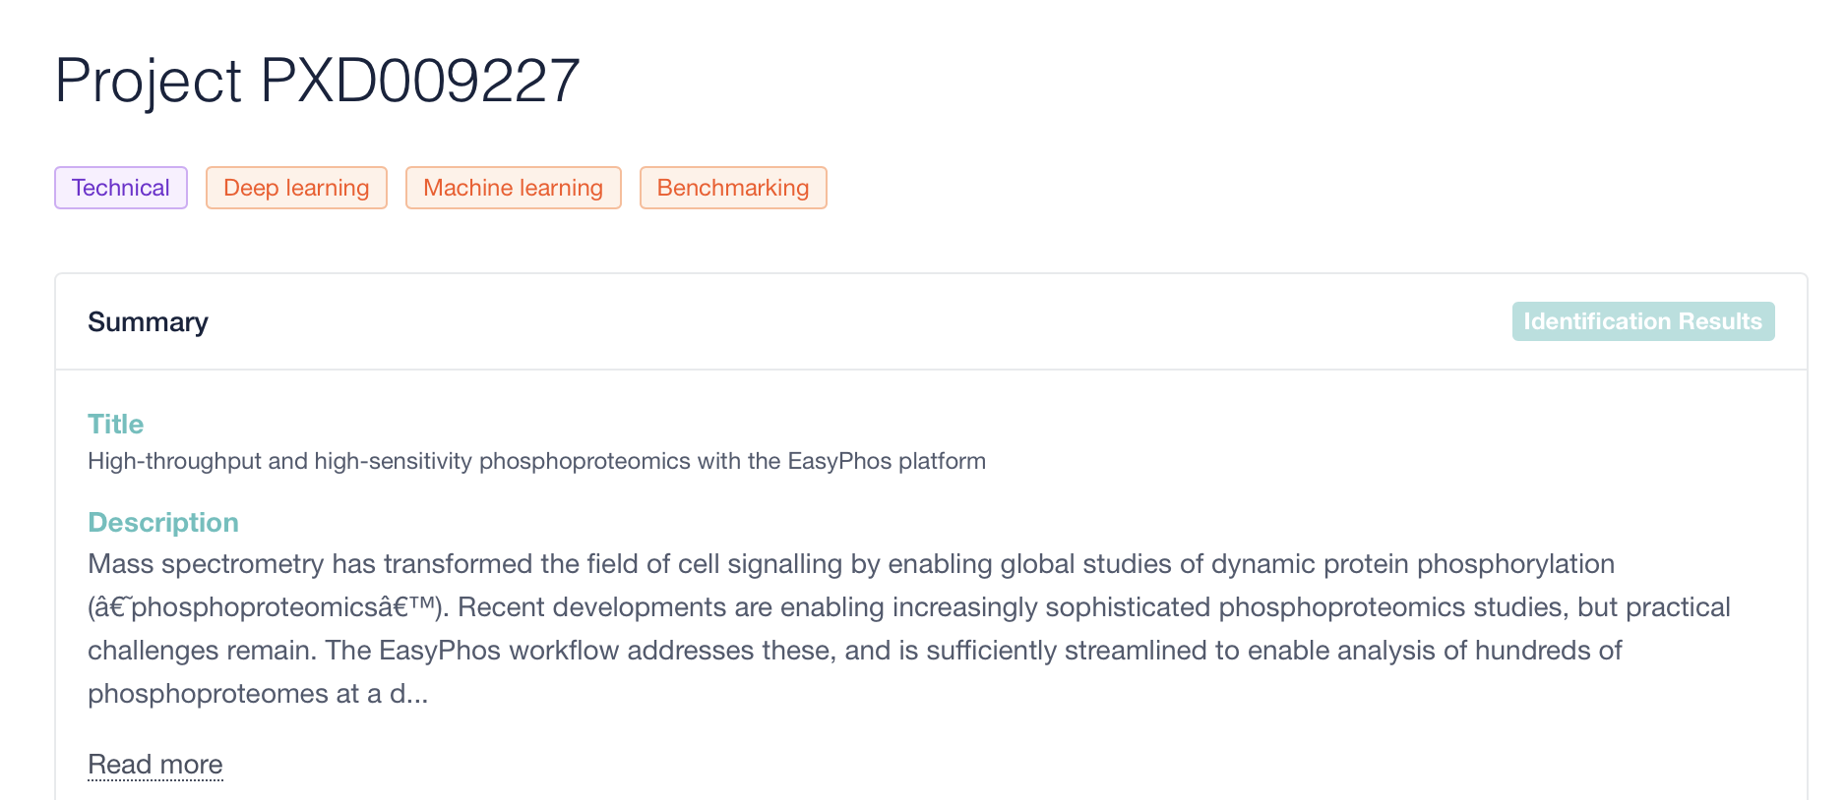
Preliminary preparation for recreating analysis

Slide 23

We’ll see!

Slide 24
More realistic goals
Use Datasets 3 and 4 to check the automated workflow (look for extremely similar, but maybe not identical results)
Recreate analysis
Create an automated workflow for a dual-search (Nextflow, Docker)
Install and use their PACOM visualization tool (Github) for figures
Recreate analysis for their 4 datasets (check data availability, methods)
Compare results (likely for the protein overlap, if time also for quantification and search space)
Apply workflow to additional datasets
Compile heterogenous proteomics datasets (different instruments, yields, experiments)
Run automated dual-search -> PACOM and compare effect on reproducibility
Notes:
#Methods
1. Recreate analysis
- Set up workflow to automate dual-search strategy
- Install PACOM visualization tool
- Download and run dual-search on 4 datasets used
- Compare figures and results (from dual-search strategy only, not additional quantification reproducibility and search space analyses)
2. Apply workflow to additional datasets
- Compile heterogenous set of datasets (different instruments, experiments, yield sizes)
- Run dual-search, run PACOM
- Same effect? (i.e. increased reproducibility)
Additional thoughts
- Try Snakemake or Nextflow
- Try Docker? Might not be applicable to this
- Potential add-on for step 1: recreate dual-search strategy in a git+snakemake+docker pipeline so it is automated and ready to go for the next time I want to use it

